Slide 1
UNIT-4
Chapter-18 Interaction Diagrams

Slide 2
Ch-18 Interaction Diagrams
Sequence diagrams and collaboration diagrams- both of which are called interaction diagrams used in the UML for modeling the dynamic aspects of systems.

Slide 3
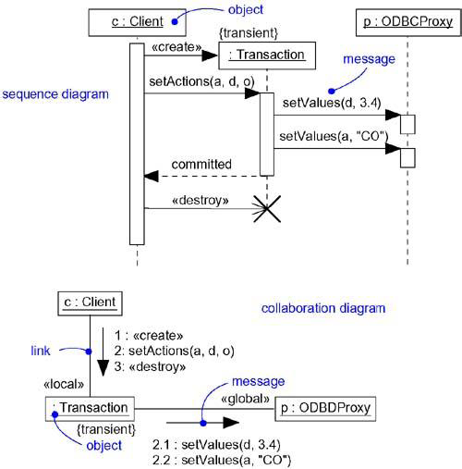
Interaction Diagrams

Slide 4
An interaction diagram shows an interaction, consisting of a set of objects and their relationships, including the messages that may be dispatched among them.
A sequence diagram is an interaction diagram that emphasizes the time ordering of messages.

Slide 5
A collaboration diagram is an interaction diagram that emphasizes the structural organization of the objects that send and receive messages.

Slide 6
Interaction diagrams commonly contain
Objects
Links
Messages
Like all other diagrams, interaction diagrams may contain notes and constraints.

Slide 7
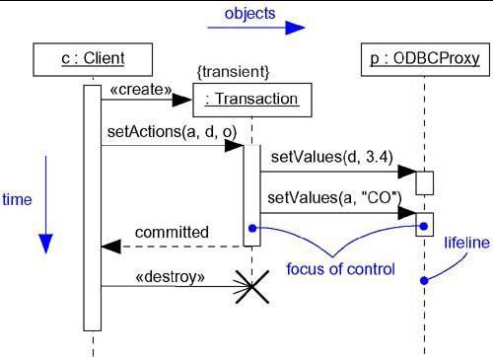
Sequence Diagrams

Slide 8
Sequence Diagrams
A sequence diagram emphasizes the time ordering of messages.
As Figure shows, you form a sequence diagram by first placing the objects that participate in the interaction at the top of your diagram, across the X axis.
Typically, you place the object that initiates the interaction at the left, and increasingly more subordinate objects to the right.

Slide 9
Next, you place the messages that these objects send and receive along the Y axis, in order of increasing time from top to bottom.
This gives the reader a clear visual cue to the flow of control over time.

Slide 10
Lifeline:- An object lifeline is the vertical dashed line that represents the existence of an object over a period of time.
Objects may be created during the interaction. Their lifelines start with the receipt of the message stereotyped as create. Objects may be destroyed during the interaction. Their lifelines end with the receipt of the message stereotyped as destroy (and are given the visual cue of a large X, marking the end of their lives).

Slide 11
Focus of control:- The focus of control is a tall, thin rectangle that shows the period of time during which an object is performing an action.
The top of the rectangle is aligned with the start of the action; the bottom is aligned with its completion (and can be marked by a return message).

Slide 12
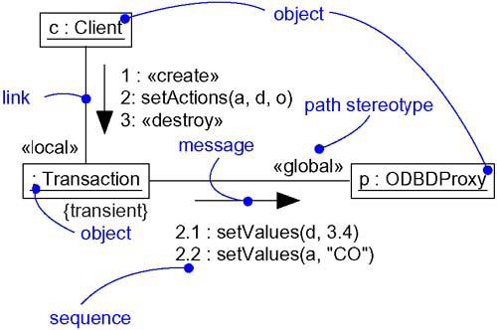
Collaboration Diagrams

Slide 13
Collaboration Diagrams
A collaboration diagram emphasizes the organization of the objects that participate in an interaction.
As Figure shows, you form a collaboration diagram by first placing the objects that participate in the interaction as the vertices in a graph.

Slide 14
Next, you render the links that connect these objects as the arcs of this graph.

